Slide 1
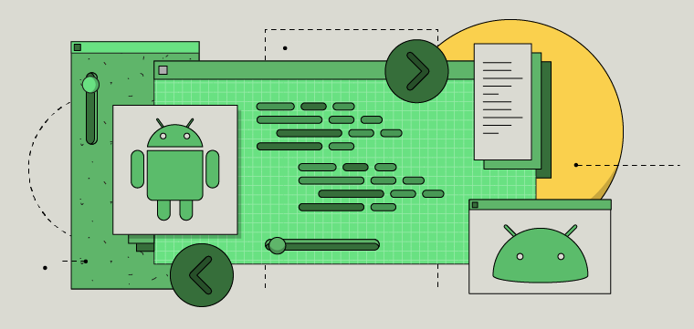
Material Design for Android

Slide 2
Material Design for Android
https://material.io/develop/android
https://codelabs.developers.google.com/codelabs/mdc-101-java
https://codelabs.developers.google.com/codelabs/material-motion-android
https://developer.android.com/guide/topics/ui/look-and-feel

